Slide 1
GitHub Collaboration and
Project Week
Lesson 8.1

Slide 2
Project Week Overview

Slide 3

You Made It to Project Week!
Notes:
shutterstock_632097335

Slide 4
Welcome to Project Week (6:35 – 6:45, 10 mins)
We will be going over collaborative workflows with Git before diving into working on projects.
In addition to just using Git and Github to push up our own code,
these powerful tools allow allows multiple developers to work on the same codebase independently of each other.
You should sit with your groups during today's activities and work to follow along with the examples.

Slide 5
Welcome to Project Week (6:35 – 6:45, 10 mins)
Here’s a free mockup tool
pencil project is a free open-source desktop GUI prototyping tool.
In Day 2 of Project Instruction
We will be showing you how to use GitHub Projects.
We let you know this ahead of time so you don't use Trello or another board.

Slide 6



Project Week at a Glance: This Week (6:35 – 6:45 10 mins)
Day 1:
Day 2:
Divide into groups.
Dive in to project development.
Begin researching APIs.
Work closely with instructors and TAs.
Outline project ideas.
Day 3:
Submit project proposal for approval.
Continue project development.
Begin initial design work.

Slide 7
Project Week at a Glance: Next Week (6:35 – 6:45 10 mins)
Day 4:
Continue project development.
Day 5:
Continue project development.
Prepare for presentations.
Day 6:
Give presentations!

Slide 8
The Great Push (6:35 – 6:45 10 mins)
Take Project Week seriously.
Use Project Week as an opportunity to push yourself and prove what you know.
Because you DO know!
Today:
Deliver a half page proposal to instructors by end of class.
You can just slack me the file.
This won’t be kept for official purposes.
It is merely so we have a way to review their final plans for feasibility.

Slide 9
Project Teams Break into your teams

Slide 10
Project Requirements (6:45 – 6:
Use at least two APIs.
Use AJAX to pull data.
Use at least one new library or technology that we haven’t discussed.
Create a polished front end/UI .
Meet good quality coding standards (indentation, scoping, naming, etc.).
Do NOT use alerts, confirms, or prompts (look into modals).
Incorporate some sort of repeating element (table, columns, etc.).
Use Bootstrap or an alternative CSS framework.
Deploy your site to GitHub Pages.
Include user input validation.

Slide 11
Bonus
Utilize Firebase for persistent data storage.
Make your site mobile responsive.
Use an alternative CSS framework such as Materialize.

Slide 12
Presentation Requirements
You will be responsible for preparing a formal, 10-minute presentation that covers the following:
The overall concept of your application
Your motivation for developing the application
Your design process
Technologies used (and a brief description of how they work)
A demonstration of the application’s functionality
Directions for future development
Treat the presentation seriously!
Sometimes, talking intelligently about tech > doing tech.

Slide 13
Metrics

Slide 14
Project Metrics
Your project will be evaluated on the following:
Concept
Design
Functionality
Collaboration
Presentation

Slide 15
Awards
Projects will receive awards in the following areas:
Most Awe-Inspiring
Most Useful
Most Creative
Best Use of Tech
Best UI/UX
Most Hilarious
Most Disruptive
Most Socially Conscious

Slide 16
API Suggestions

Slide 17
API Suggestions
Stick to APIs that do all of the following:
Allow cross-origin resource sharing (CORS)
Require simple or no authentication
Return a JSON response
Are well documented

Slide 18
API Suggestions
Find a collective list (updated daily!) of free APIs for use in software and web development here: public-apis
Spotify | Pinterest
Reddit | Google
YouTube | Tumblr
LinkedIn | OpenStreetMap
SoundCloud | Giphy
Wikipedia | BitCoinCharts
Flickr | Stack Exchange

Slide 19
Tools

Slide 20

Collaboration Is Critical!
Steering a project with remote developers can be challenging.
Consider using the following tools.
Notes:
shutterstock_81648802

Slide 21





GitHub Pull Requests
GitHub pull requests are a great way to “combine” code when multiple users are working on the same files. We’ll show you how to use this feature in the next class.
 | Git Branch <branchname> Creates a local branch, or alternative version of code. However, the "master" branch is still the active branch. | Git Checkout <branchname> Switches the active branch to the alternative branch. Local code files and changes will be saved to this branch.
1
2
3
4
5
6
1
2
3
4
5
6
GitHub
Versions
Versions
COMMAND
Master
New Branch
New Branch
Master
Now Active
YOUR COMPUTER
Local Project Folder
Local Project Folder
Notes:
Trilogy created this diagram and it doesn’t violate copyright laws.

Slide 22
GitHub Issues are a great way to keep track of bugs, feature requests, and more.

Slide 23
GitHub Projects is a great
project management tool
for creating to-do lists and communicating updates.

Slide 24
Example Project Ideas

Slide 25

Example Project Ideas
Event Searcher:
Users type in the name of their favorite sports team.
Using the SeatGeek API, your web application points users to the time and location of the team’s next game.
The web application also provides users with an eBay link to purchase memorabilia associated with the team.
Notes:
Image from: shutterstock_404793301

Slide 26
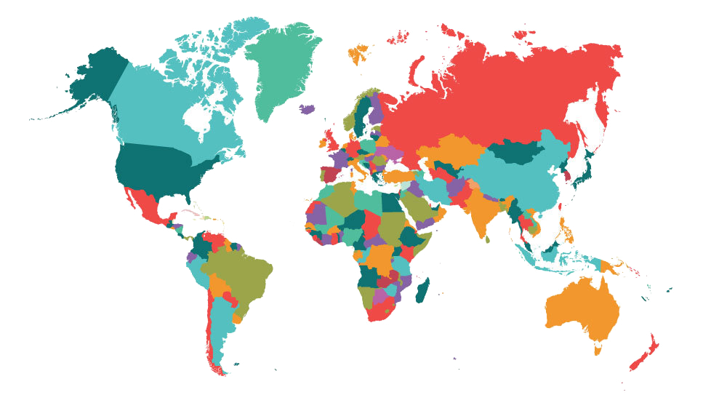
Example Project Ideas
UN Data API:
Use the unofficial UN Data API to search a user-specified country’s health records.
Use a secondary data source (Google Maps, Flickr, YouTube, etc.) to provide additional context or data.
Examples: per capita government expenditures on health; number of physicians; deaths due to HIV, malaria, etc.; low-birth-weight newborns.
Notes:
Image from: shutterstock_525077839

Slide 27

Example Project Ideas
Facial Recognition:
Use the Face++ API.
Allow users to provide a link to a facial image, and then provide viewers with information about the image’s gender, race, age, and whether they are wearing glasses.
Notes:
Image from: shutterstock_1255208941

Slide 28

Or just do your own thing.
Be creative! Be ambitious!

Slide 29
Today’s Focus

Slide 30
Today’s Project Checklist
Brainstorm possible project ideas.
BeginAPI research.
Create an initial draft and sketch of the design.
Create a short (1 page) proposal that contains the following:
Project title
Sketch of the design
Team Members / Team Name
APIs to be used
Project description
Rough breakdown of tasks

Slide 31
Questions?

